Slide 1


CRUD with MockAPI
Conventions that facilitate viewing, searching, and changing information.

Slide 2
Overview of Today’s Session
mock API
1
2
3
4
+
Create
Read
Update
Delete

Slide 3
What is CRUD?
Create - Adds new entries via the POST request Read - Retrieve, Search, or View existing entries via the GET request Update - Edit existing entries via the PUT request Delete - Remove existing entries via the DELETE request

Slide 4
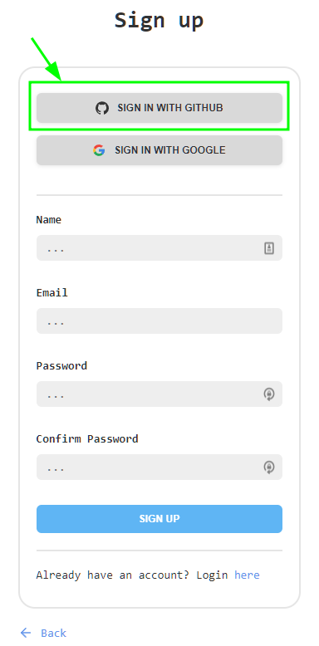
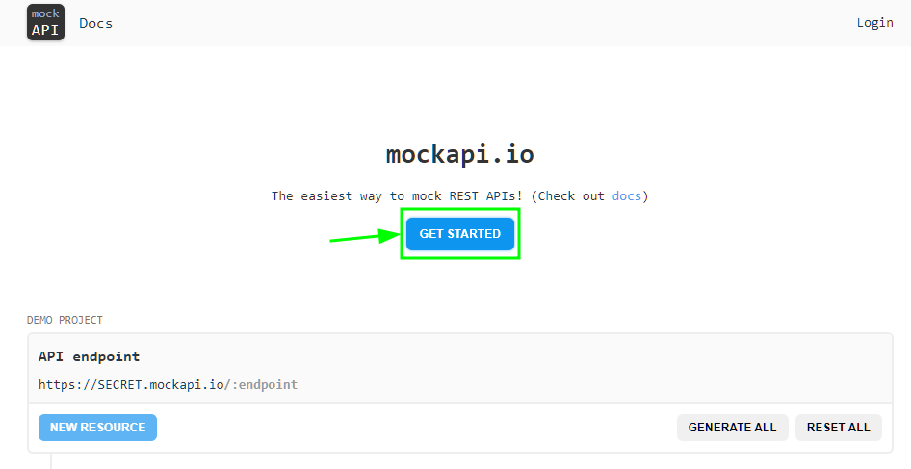
Getting Started
Go to MockAPI
Create your account using GitHub

Slide 5
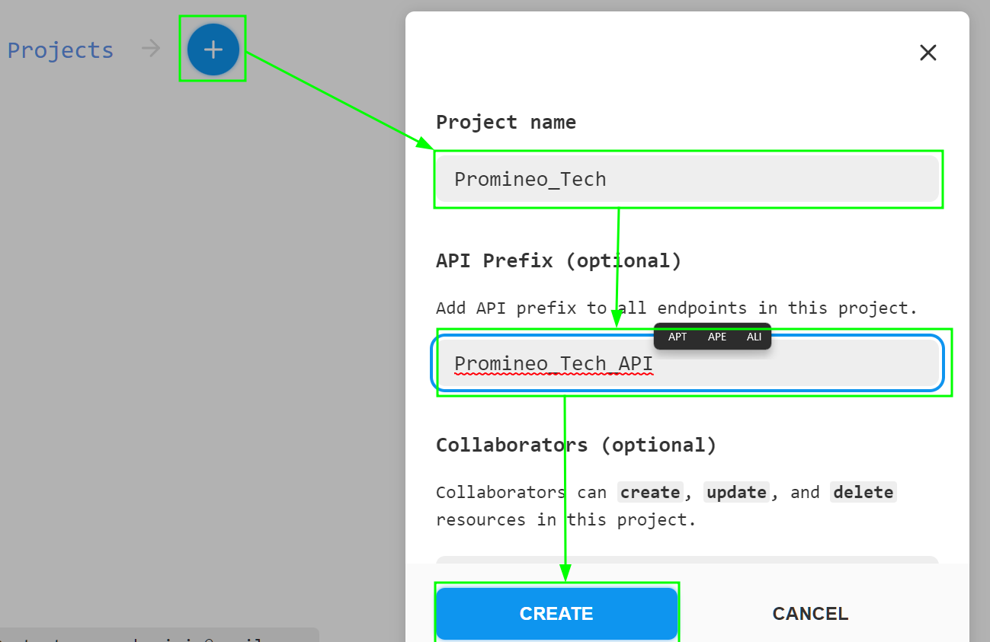
Creating a Project
Give your project a name and API Prefix and click create.

Slide 6
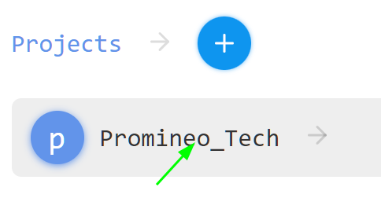
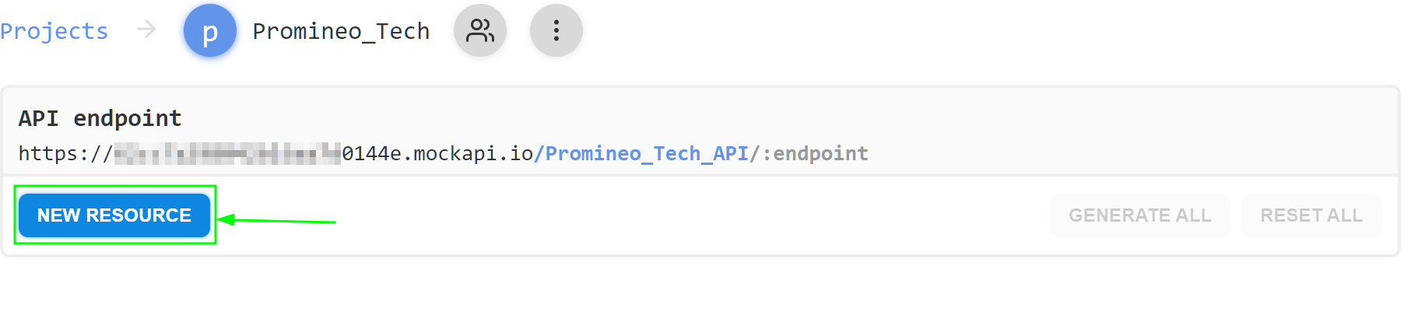
Creating a Resource
Click on your project and then click on New Resource.

Slide 7
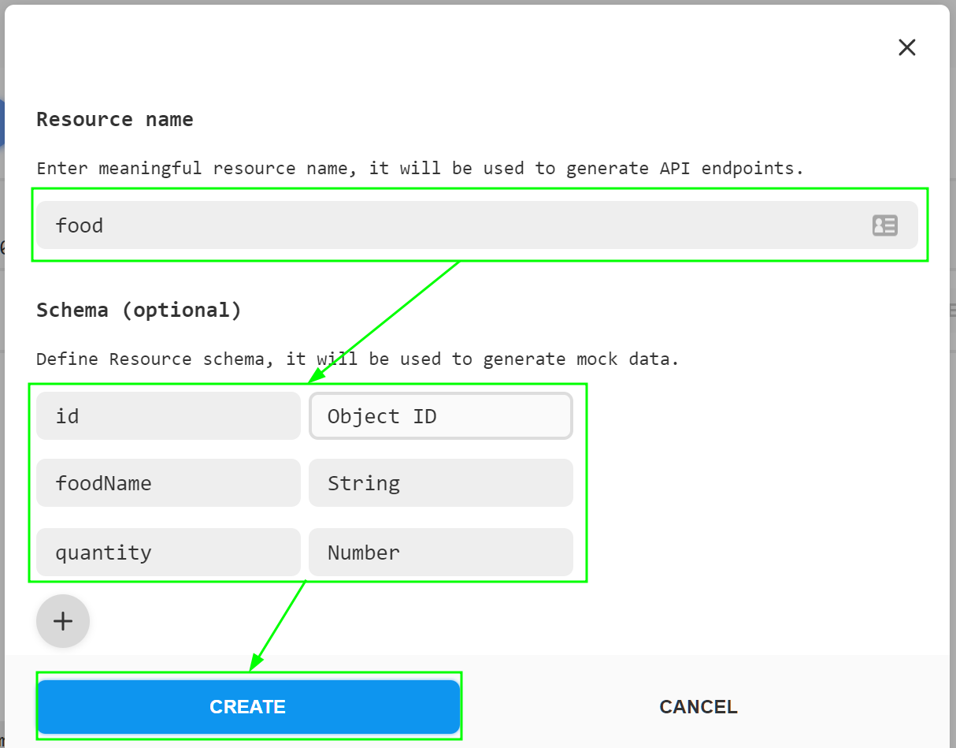
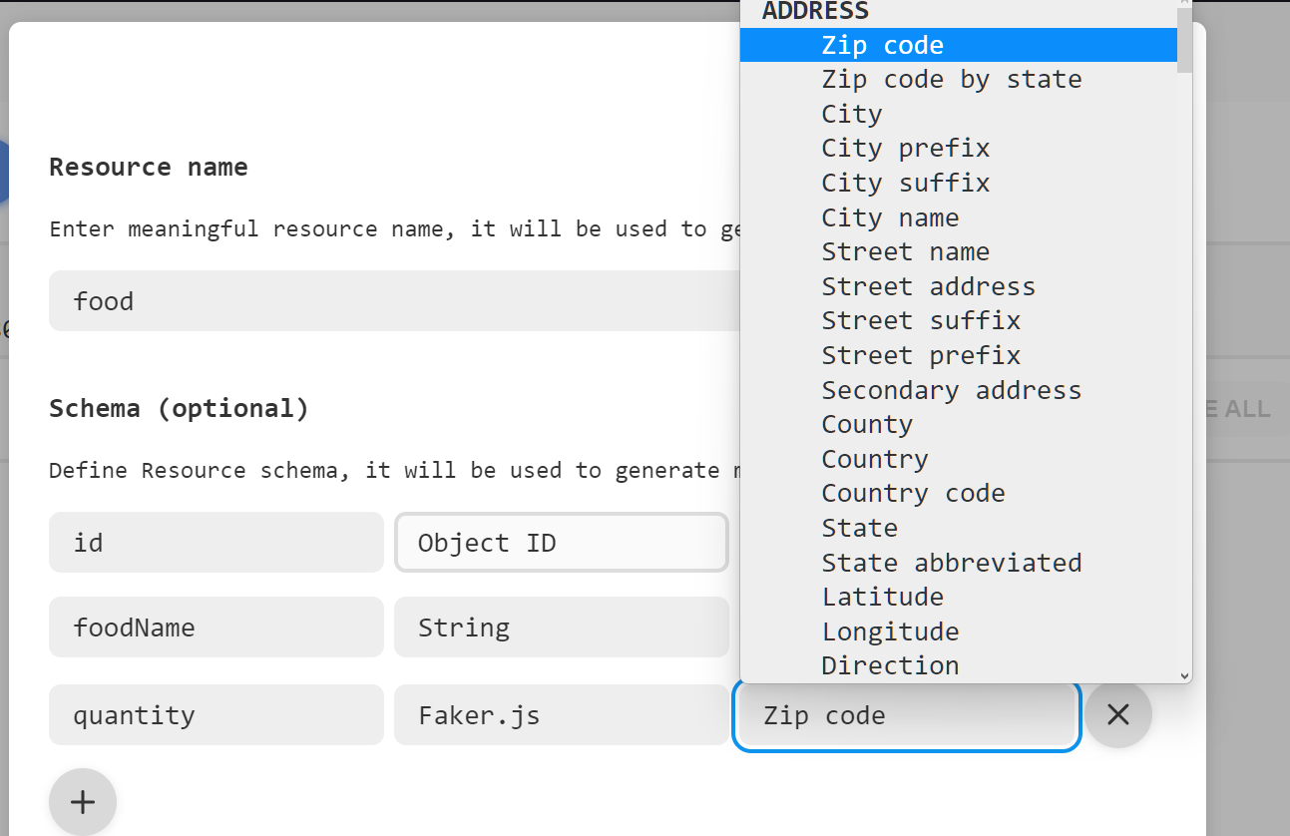
Creating a Resource
Give your resource a name and property names, then click create.
MockAPI accepts multiple values such as strings, numbers, arrays, objects, and more!
See more details on https://mockapi.io/docs

Slide 8
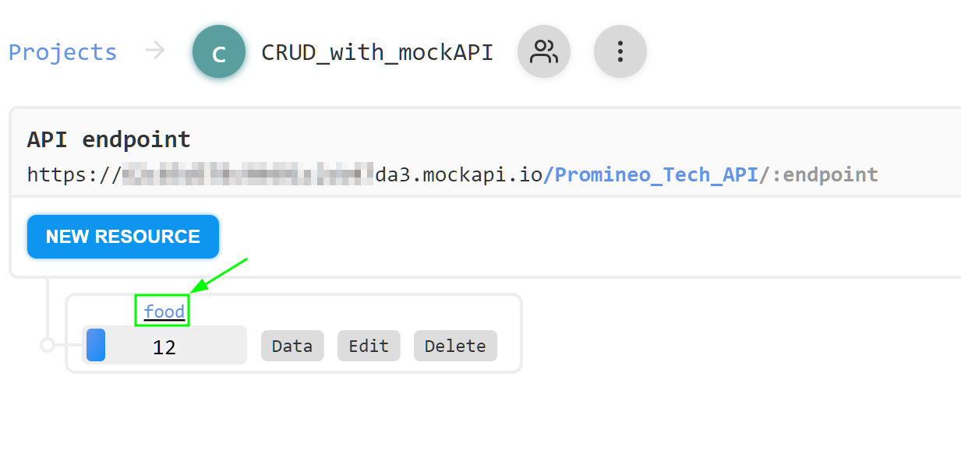
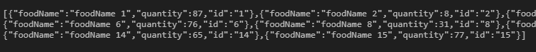
Viewing a Resource
Click on your resource name to view the endpoint array Data.
foodGroupData: [{"foodName":"foodName 1","quantity":87,"id":"1"}]

Slide 9
What is my Endpoint???
This is the link between your code and the server.
Account/API-Prefix/Endpoint
https://12345d578c90491c2cb47da3.mockapi.io
/Promineo_Tech_API
/food
const URL = “https://12345d578c90491c2cb47da3.mockapi.io/Promineo_Tech_API/food”

Slide 10
Create
//crud - create using jquery
function createFoodGroup(foodGroup) {
console.log("createFoodGroup foodGroup:", foodGroup); //log the food group to be created
return $.ajax({ //return the ajax request
url: URL, //pass the url of the food group to be created
data: JSON.stringify(foodGroup), //pass the food group to be created
dataType: "json", //set the data type to be json
type: "POST", //set the type of request to be a post request
contentType: "application/json", //set the content type to be json
crossDomain: true, //set the cross domain to be true
});
}

Slide 11
Read
//crud - read usning jquery
function getFoodList() {
console.log(“Should return an array of my food data”, URL)
return $.get(URL); //get the list of food groups from the url
}

Slide 12
Update
//crud - update using jquery
function updateFoodGroup(foodGroupData) {
console.log("createFoodGroup foodGroup:", foodGroupData); //log the food group to be created
let newFoodName = foodGroupData.foodName; //get the new food name value
// console.log("updateFoodGroup food name:", newFoodName); //log the new food group name
let foodId = parseInt(foodGroupData.id)
// console.log("updateFoodGroup food name ID:", foodId ); //log the id of the food group to be updated
return $.ajax({
url: `${URL}/foodId }`, //pass the id of the food group to be updated
dataType: "json", //set the data type to be json
data: JSON.stringify({ foodName: newFoodName}), //passes the food group to be updated
contentType: "application/json", //set the content type to be json
crossDomain: true, //set the cross domain to be true
type: "PUT", //set the type of request to be a put request
});
}

Slide 13
Delete
//crud - delete using jquery function deleteFoodGroup(id) {
console.log("deleteFoodGroup food name ID:", parseInt(id.id)); //log the id of the food group to be deleted
//return the ajax request
return $.ajax({
url: `${URL}/${parseInt(id.id)}`, //pass the id of the food group to be deleted
type: "DELETE", //set the type of request to be a delete request
});
}

Slide 14
Let’s set it in Action!

